Slide 1


Start Smart 1.0
2nd Grade
Lesson 11

Slide 2

ELD Objective
ELD Objective: Students will be able to engage in a Constructive Conversation using the Constructive Conversation Skill of NEGOTIATE, by taking turns, sharing ideas and making ideas clearer with a partner based on a visual text.

Slide 3
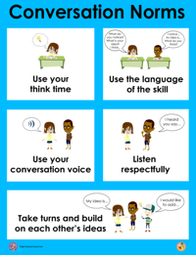
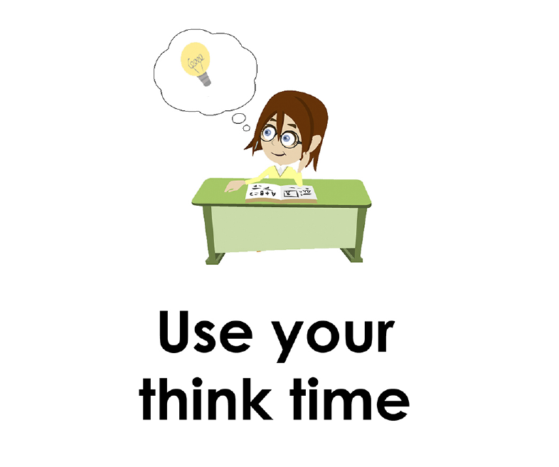
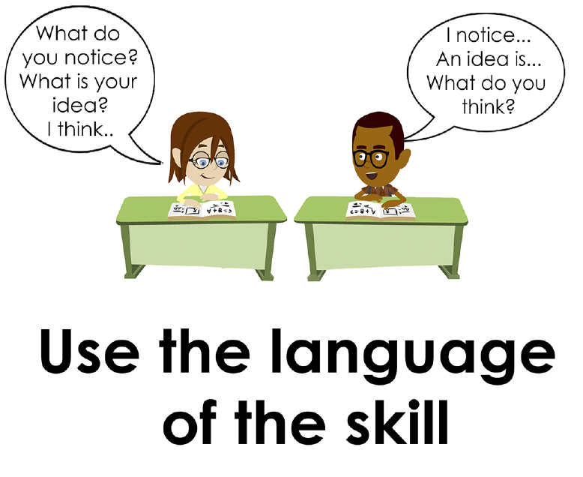
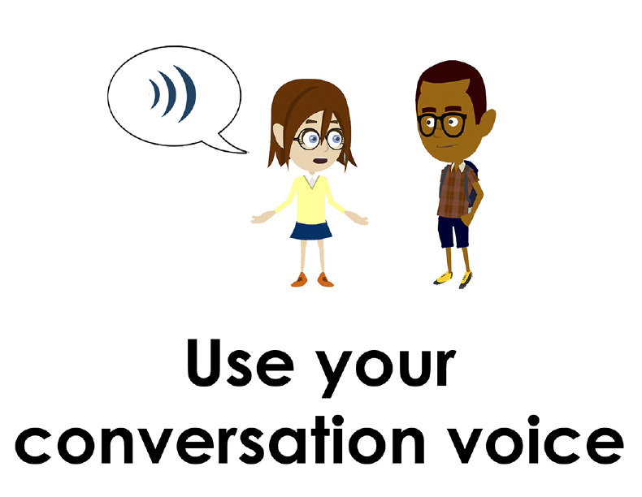
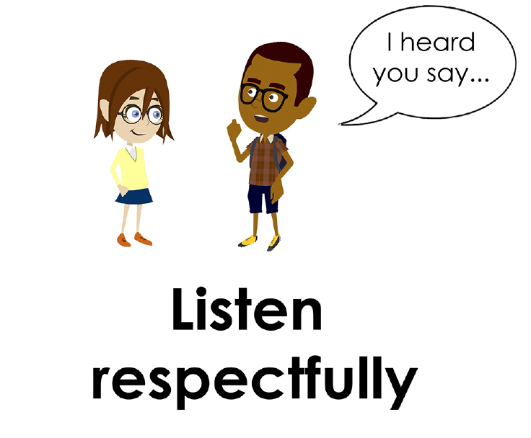
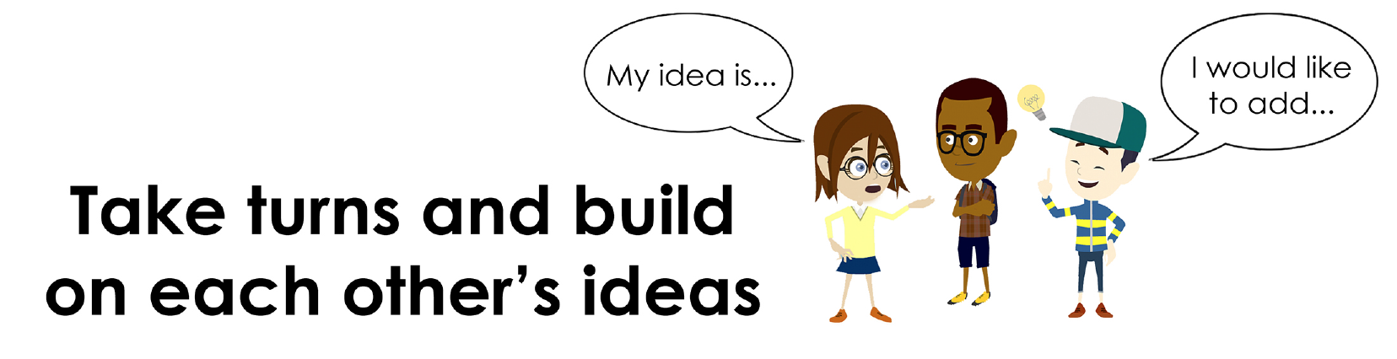
Conversation Norms Poster
  Use your think time
  Use the language of the skill
  Use your conversation voice
  Listen respectfully
  Take turns and build on each other’s ideas

Slide 4
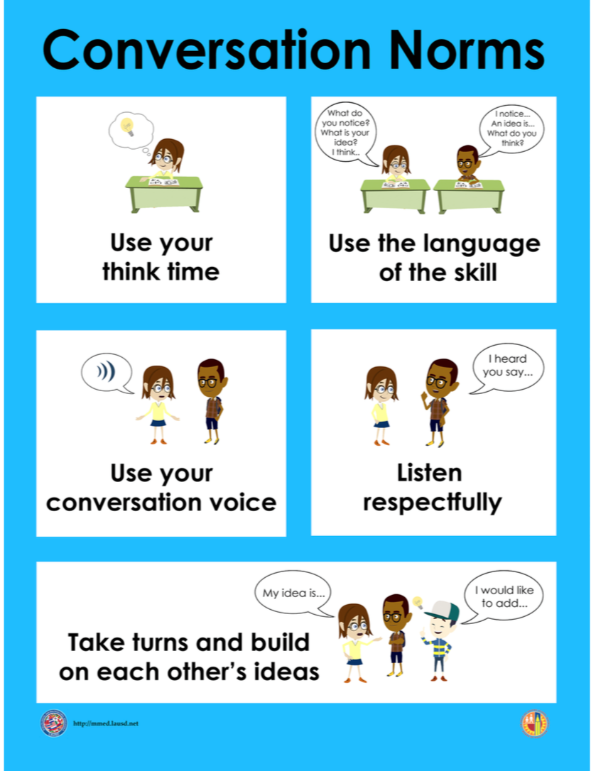
Notes:
The focus today is:
Use your think time
Use the language of the skill

Slide 5
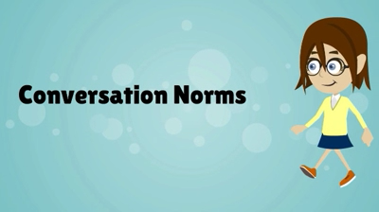
Conversation Norms
Notes:
Show Constructive Conversation Norms Video as a review of all norms

Slide 6
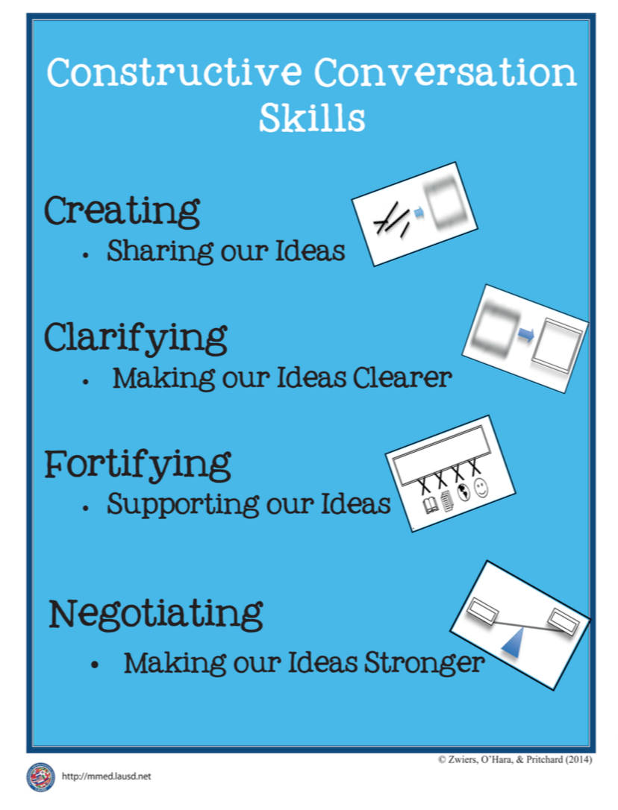
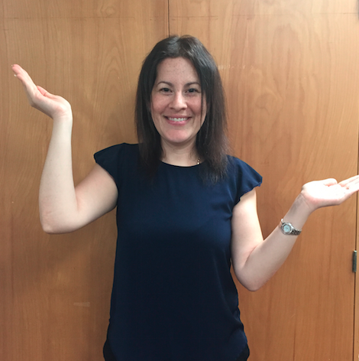
Hand Gesture and Phrase- NEGOTIATE
Making our Ideas Stronger
Notes:
Model NEGOTIATE and have participants repeat with you:
Place hand, palm down in front of you as if putting an idea on the table. Use four fingertips of the other hand to support the palm.

Slide 8
Prompt:
What is an important idea from this text? Start by stating your claim. Support your claim and come to a consensus.
TEACHER VISUAL TEXT

Slide 9


Listen to the Model Constructive Conversation
  Use your think time to study the visual text.
Listen actively to what two partners say to each other.
Notes:
Provide a copy of the Model Script to the volunteer and allow time beforehand for student to review the script. Suggestions for reading the script:
● Show a video of students having the model conversation (optional)
● Student volunteer and teacher read model script
STUDENT LISTEN ACTIVELY

Slide 10
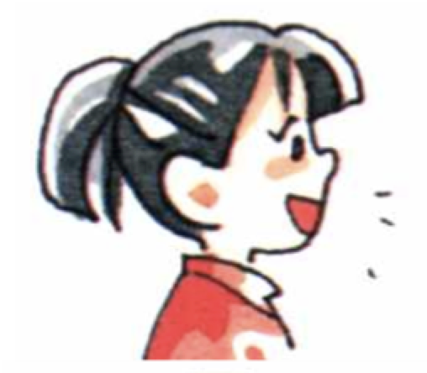
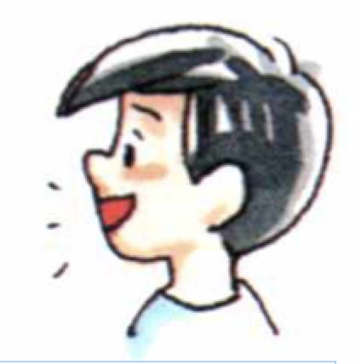
Visual Text Model
What is an important idea from this text? Start by stating your claim. Support your claim and come to a consensus.
Partner A: An important idea from the text is that you need to work together to build cars. What is your claim?
Partner A:I think that there are men working together in a group using hammers and a group putting in steering wheels, too. How can you support your claim with evidence?
Partner A:I think the men working with the steering wheel are working together because one man is grabbing a steering wheel and another man is carrying a steering wheel towards the men around the car. They are putting the steering wheel on the car together. How can you support your claim with evidence?
Partner A: I think that the men putting in the steering wheels are working together to build cars and have different jobs. Some bring the steering wheel and others attach it to the car.
Partner A:I think that the workers are showing the people how they work together to build cars. Can we come to an agreement?
Partner B: An important idea is that people are interested in how to build cars. How can you support your claim with evidence?
Partner B:I think that the many people in the back are all looking at the men build cars. They are focused on what is happening because they want to learn. How can you support your claim with evidence?
Partner B:I think that the two boys are really interested. They are hanging over the wall to get a closer look at the men building the cars. How can you support your claim with evidence?
Partner B:I think the people are watching the workers because they want to learn about how to cooperate with others to build things. How can we come to an agreement?
Partner B: I think the important idea is to learn how to do something big, we need to watch and learn from people who know how to build things by working together.

Slide 12
Listen to the Non-Model Constructive Conversation
  Use your think time to study the visual text.
Listen actively to what two partners say to each other.
Notes:
Provide a copy of the Non-­‐‑Model Script to the volunteer and allow time beforehand for student to review the script. Suggestions for reading the script:
● Show a video of students having the model conversation (optional)
● Student volunteer and teacher read model script
STUDENT LISTEN ACTIVELY

Slide 13
Visual Text Non- Model
What is an important idea from this text? Start by stating your claim. Support your claim and come to a consensus.
Partner A: You need to work to build cars.
Partner A: There are men working together in a group putting in steering wheels.
Partner A: The men getting the steering wheels are working together. The workers put the steering wheel on the car.
Partner A: The men putting in the steering wheels have different jobs.
Partner A: The workers are showing the people how to work together.
Partner B: People are interested in cars.
Partner B: Many people are watching the men.
Partner B: The two boys are really interested. They are hanging over the wall to get a closer look at the men.
Partner B: The dressed up people are learning about how to build things.
Partner B: To learn how to do something big, we need to watch and learn.

Slide 14
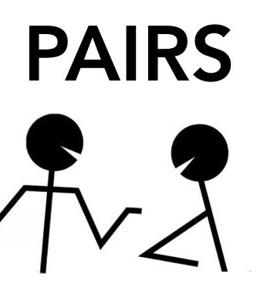
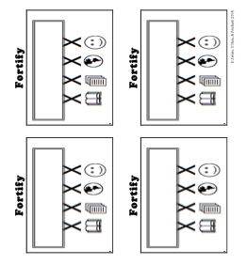
Constructive Conversation Game
PROMPT:
What is an important idea from this text? Start by stating your claim. Support your claim and come to a consensus.
Rules of the game:
Each of you needs 1 CREATE, 1 CLARIFY, 1 FORTIFY, and 2 NEGOTIATE cards
Each of you will play one card as you share an idea. You will continue taking turns until all cards are placed in the middle.
If you’re done early repeat the process for an additional round.
Remember to use the Constructive Conversation Norms and Skills as you play the game.
Notes:
You are now going to have the opportunity to practice the Constructive Conversation Skill NEGOTIATE while playing a game.
Explain the rules of the Constructive Conversation Game to students.

Slide 15

Prompt: What is an important idea from this text? Start by stating your claim. Support your claim and come to a consensus.
TEACHER COLLECTS LANGUAGE SAMPLE SPF 1.0
STUDENT VISUAL TEXT
Notes:
Display the Student Visual Text
Direct students to use their Think Time
As the students play the game, the teacher listens and selects two students who will replay the game in front of the class to serve as models.
This is an opportunity to capture a language sample.

Slide 16


CONSTRUCTIVE CONVERSATION
FISHBOWL MODEL
PROMPT: What is an important idea from this text? Start by stating your claim. Support your claim and come to a consensus.
Listen actively to what two partners say to each other.
FORMATIVE ASSESSMENT– TEACHER COLLECTS LANGUAGE SAMPLE SPF 1.0
Notes:
The two selected students will replay the game in front of the class and serve as models.
Student Progress Form (SPF)-­‐‑ Constructive Conversation Language Sample The teacher will collect a language sample from the two students on the Student Progress Form (SPF)-­‐‑ Constructive Conversation Language Sample to be used in Lesson 2. The language sample must be at least four turns in length. (Each turn includes both Partner A and B sharing

Slide 17
WRAP-UP
How did we meet today’s objective of using the Constructive Conversation Skill of NEGOTIATE?
How did you:
    Use your think time?
    Use the language of the skill
  Work with your conversation partner to do the following:
    Identify three things that you did to meet today’s objective
    Share and explain the three things to your partner
Notes:
Teacher will review ELD objective.
Today we engaged in a Constructive Conversation using the Constructive Conversation Skill-­‐‑NEGOTIATE. We took turns and shared ideas based on a visual text.
Teacher will ask students the following:
● How did we meet today’s objective of using the Constructive Conversation Skill of NEGOTIATE?
● How did you:
-Use your think time
-Use the language of the skill
● Work with your conversation partner to do the following:
Identify three things that you did to meet today’s objective
Share and explain the three things to your partner
Teacher calls on three students and they tell the class what was done today.

Slide 18
Start Smart 1.0
NEGOTIATE
1st Grade
Lesson 12

Slide 19
ELD Objective
Students will be able to revise a Non-Model Conversation for the Constructive Conversation Skill- NEGOTIATE in a whole group setting and with a triad.
Notes:
Today we are going to review the Constructive Conversation Skill-­‐‑FORTIFY. When we create, we say what we notice about something.

Slide 20
Notes:
Let’s review the Conversation Norms Poster
Today, we will focus on:
Use the language of the skill
Use your conversation voice
**Give examples for both. Ask for student volunteers to model the two norms.

Slide 21
Conversation Norms
Notes:
Show Constructive Conversation Norms Video as a review of all norms

Slide 22
Hand Gesture and Phrase- NEGOTIATE
Making our Ideas Stronger
Notes:
Model NEGOTIATE and have participants repeat with you:
Place hand, palm down in front of you as if putting an idea on the table. Use four fingertips of the other hand to support the palm.

Slide 23
Prompt and Response Starters
Prompt Starters:
What is your claim…?
What is an important idea…?
Do you agree? Why?
Do you disagree? Why?
Response Starters:
My claim is…
An important idea is…
I agree because…
I disagree because…
Notes:
Display the Visual Text for Teacher Modeling, Negotiate Skill Poster and Listening Task Poster.
To model what a Constructive Conversation looks like we are going to use the visual text and the Listening Task Poster to address the following prompt: What is an important idea from this text? Start by stating your claim. Support your claim and come to a consensus. As we look at the visual text, we will NEGOTIATE, share our own ideas and come to a consensus.
Today I am going to model using the Constructive Conversation Skill of NEGOTIATE using these prompt and response starters. They will help us to communicate our ideas clearly. Have students round robin or chorally read previously charted prompt and response starters:

Slide 24
Notes:
Review Model
Remind students that we used this visual text before in a FORTIFY conversation. Say: Use ideas from that conversation to support your claim. Teacher introduces Model and asks for a previously selected volunteer to be their partner. Teacher and student read Model Script. Model using think time before speaking. Teacher will also discuss how the following norms were used during the conversation:
use the language of the skill
use your conversation voice

Slide 25
Prompt: What is an important idea from this text? Start by stating your claim. Support your claim and come to a consensus.
TEACHER VISUAL TEXT
Notes:
Display the Student Visual Text
Direct students to use their Think Time

Slide 26
Listen to the Model Constructive Conversation
  Use your think time to study the visual text.
Listen actively to what two partners say to each other.
Notes:
Provide a copy of the Model Script to the volunteer and allow time beforehand for student to review the script. Suggestions for reading the script:
● Show a video of students having the model conversation (optional)
● Student volunteer and teacher read model script
STUDENT LISTEN ACTIVELY

Slide 27
What makes this a model conversation?
Partner A: An important idea from the text is that you need to work together to build cars. What is your claim?
Partner A: I think that there are men working together in a group using hammers and a group putting in steering wheels, too. How can you support your claim with evidence?
Partner A: I think the men working with the steering wheel are working together because one man is grabbing a steering wheel and another man is carrying a steering wheel towards the men around the car. They are putting the steering wheel on the car together. How can you support your claim with evidence?
Partner A: I think that the men putting in the steering wheels are working together to build cars and have different jobs. Some bring the steering wheel and others attach it to the car.
Partner A: I think that the workers are showing the people how they work together to build cars. Can we come to an agreement?
Partner B: An important idea is that people are interested in how to build cars. How can you support your claim with evidence?
Partner B: I think that the many people in the back are all looking at the men build cars. They are focused on what is happening because they want to learn. How can you support your claim with evidence?
Partner B: I think that the two boys are really interested. They are hanging over the wall to get a closer look at the men building the cars. How can you support your claim with evidence?
Partner B: I think the people are watching the workers because they want to learn about how to cooperate with others to build things. How can we come to an agreement?
Partner B: I think the important idea is to learn how to do something big, we need to watch and learn from people who know how to build things by working together.
Notes:
Teacher will use questions and the Listening Task Poster to guide students through an analysis of what makes this a Model Constructive Conversation for the skill of NEGOTIATE.

Slide 28
Understanding the Skill of NEGOTIATE
Partner A: An important idea from the text is that you need to work together to build cars. What is your claim?
Partner A: I think that there are men working together in a group using hammers and a group putting in steering wheels, too. How can you support your claim with evidence?
Partner A: I think the men working with the steering wheel are working together because one man is grabbing a steering wheel and another man is carrying a steering wheel towards the men around the car. They are putting the steering wheel on the car together. How can you support your claim with evidence?
Partner A: I think that the men putting in the steering wheels are working together to build cars and have different jobs. Some bring the steering wheel and others attach it to the car.
Partner A: I think that the workers are showing the people how they work together to build cars. Can we come to an agreement?
Partner B: An important idea is that people are interested in how to build cars. How can you support your claim with evidence?
Partner B: I think that the many people in the back are all looking at the men build cars. They are focused on what is happening because they want to learn. How can you support your claim with evidence?
Partner B: I think that the two boys are really interested. They are hanging over the wall to get a closer look at the men building the cars. How can you support your claim with evidence?
Partner B: I think the people are watching the workers because they want to learn about how to cooperate with others to build things. How can we come to an agreement?
Partner B: I think the important idea is to learn how to do something big, we need to watch and learn from people who know how to build things by working together.
Notes:
Understanding the Skill: Negotiate
Teacher displays or distributes the Model Script from Lesson 11.
Example of Think-Aloud:
Student A:
I think the men working with the steering wheel are working together because one man is grabbing a steering wheel and another man is carrying a steering wheel towards the men around the car. F They are putting the steering wheel on the car together. How can you support your claim with evidence? F
NOTE: The sample above highlights the use of the skill FORTIFY within a NEGOTIATE conversation. The sample below is used to highlight the components of NEGOTIATE skill within the same conversation.
Student A:
I think the people are watching the workers because they want to learn about how to cooperate with others to build things. CL How can we come to an agreement? N
Student B:
I think that the workers are showing the people how they work together to build cars. CL Can we come to an agreement? N
Student A:
I think the important idea is to learn how to do something big, we need to watch and learn from people who know how to build things by working together. N
Let’s look at the Model Script to find evidence of the skills of NEGOTIATE, FORTIFY, CREATE, and CLARIFY. How are we using the visual text to guide our conversation?
Let’s look at the last three turns. Read them to yourself as I read them aloud (see example above).
Let’s look at the language of the skill. Look at Student A’s response. How do I know Student A used the skill of NEGOTIATE? I see the language of the skill (underline as noted above). I know this is NEGOTIATE because it is asking to come to an agreement so I will label it with N (Write N next to the response.) Student A is also using evidence from the text to support his idea (Write F next to the response). I also notice that Student B is using the language of the skill to state their claim, so I will label it with N (Write N next to the response and underline as noted above). Also, they use the language of CLARIFY and ask a clarifying question to help learn more from Student A to make their idea stronger (Write CL next to the response). Then Students A and B clarify their ideas and ask questions to understand each other’s evidence (Write CL next to the responses).
Teacher prompts students to go throughout the same process with the rest of the Model Conversation.

Slide 30
Listen to the Non-Model Constructive Conversation
  Use your think time to study the visual text.
Listen actively to what two partners say to each other.
Notes:
Provide a copy of the Non-Model Script to the volunteer and allow time beforehand for student to review the script. Suggestions for reading the script:
● Show a video of students having the model conversation (optional)
● Student volunteer and teacher read model script
STUDENT LISTEN ACTIVELY
STUDENTS SHOULD LISTEN ACTIVELY

Slide 31
REVIEW Text Non- Model
What is an important idea from this text? Start by stating your claim. Support your claim and come to a consensus.
Partner A: You need to work to build cars.
Partner A: There are men working together in a group putting in steering wheels.
Partner A: The men getting the steering wheels are working together. The workers put the steering wheel on the car.
Partner A: The men putting in the steering wheels have different jobs.
Partner A: The workers are showing the people how to work together.
Partner B: People are interested in cars.
Partner B: Many people are watching the men.
Partner B: The two boys are really interested. They are hanging over the wall to get a closer look at the men.
Partner B: The dressed up people are learning about how to build things.
Partner B: To learn how to do something big, we need to watch and learn.
Notes:
Review Non-Model
Teacher displays or distributes the Non-Model Script from Lesson 11.
Let’s look at the Non-Model Script. How can we improve this Constructive Conversation? This was our prompt, “What is an important idea from this text? Start by stating your claim. Support your ideas and come to a consensus.” Here’s the visual text. Read it to yourself as I read it aloud. Think about the prompt and the language of the Constructive Conversation Skill NEGOTIATE.
Teacher will use questions and the Listening Task Poster to guide students through an analysis of what makes this a Non-Model Constructive Conversation for the skill of NEGOTIATE. See possible responses below.
No, they did not take turns sharing their ideas because partner A spoke two times in a row, without letting partner B take a turn
At first, they responded to the prompt, but towards the end they went off topic
They did not build on each other’s ideas
Teacher along with students will revise the text on chart paper or document reader.
Prompt: What is an important idea from this text? Start by stating your claim. Support your claim and come to a consensus.
Non-Model:
Student A:
You need to work to build cars. (Student does not start by making a claim; not prompting other partner)
Student B:
People are interested in cars. (Student does not start by making a claim; not prompting other partner)
Student A:
There are men working together in a group putting in steering wheels. (not prompting other partner)
Student B:
Many people are watching the men. (not prompting other partner)
Student A:
The men getting the steering wheels are working together. The workers put the steering wheel on the car. (not prompting other partner)
Student B:
The two boys are really interested. They are hanging over the wall to get a closer look at the men. (not using language of the skill; not using evidence from the text to support the claim)
Student A:
The men putting in the steering wheels have different jobs. (not prompting other partner; not using evidence from the text to support the claim)
Student B:
The dressed up people are learning about how to build things. (not using language of the skill; not using evidence from the text to support the idea)
Student A:
The workers are showing the people how to work together. (not coming to a consensus)
Student B:
To learn how to do something big, we need to watch and learn. (not coming to a consensus)

Slide 32
REVISE
NON-MODEL
Note to Teacher: Consult pg. 40-41 of Start Smart 1.0 Lessons or Teacher Resources at end of
Power point
WHOLE-GROUP/CLASS REVISED NON-MODEL
Notes:
Teacher along with students revise the text on chart paper or document reader.
Revised* Non-Model:
*text indicates what the teacher should cross out as the text is being revised.
Bold indicates language revised.
Student A:
An important idea from the text is that yYou need to work together to build cars. What is your claim?
Student B:
An important idea is that people are interested in how to build cars. How can you support your claim with evidence?
Student A:
I think that tThere are men working together in a group putting in steering wheels. How can you support your claim with evidence?
Student B:
I think that the many people in the back are watching the men work because they want to learn how to build cars. How can you support your claim with evidence?
Student A:
I think tThe men getting the steering wheels are working together because one man grabs the steering wheel and the other one hands it to the other workers. The workers put the steering wheel on the car together. How can you support your claim with evidence?
Student B:
I think that tThe two boys are really interested. They are hanging over the wall to get a closer look at the men who build the cars. How can you support your claim with evidence?
Student A:
I think that tThe men putting in the steering wheels have different jobs. Two men bring the steering wheel and others attach it to the car. They work together. Now what do you think is happening?
Student B:
I think tThe dressed up people are learning about how to build things by watching the men build cars together. How can we come to an agreement?
Student A:
I think that tThe workers are showing the people how to work together to build cars. Can we come to an agreement?
Student B:
I think the important idea is tTo learn how to do something big, we need to watch and learn from people who know how to work together to build things.
3. Refer to class revised Non-Model, have pairs read.

Slide 33
Prompt: What is an important idea from this text? Start by stating your claim. Support your claim and come to a consensus.
Notes:
Display the Student Visual Text
Direct students to use their Think Time

Slide 34

Language Sample Revision-Non-Model
You will work in a triad:
Number off from 1-3 to form a triad and select a student who will record the revision of the language sample
Read the language sample
Orally revise the language sample to improve the conversation
Use the prompt and response starters for NEGOTIATE
Be prepared to share out to the class
FORMATIVE ASSESSMENT– TEACHER COLLECTS LANGUAGE SAMPLE SPF 1.0
Notes:
Teacher will review ELD objective.
Today we revised a NEGOTIATE Non-­‐‑Model Constructive Conversation. We took turns and shared ideas based on a visual text.
Teacher asks students the following:
● How did we meet today’s objective of using the Constructive Conversation Skill of NEGOTIATE?
● How did you:
o use the language of the skill o use your conversation voice
● Work with your conversation partner to do the following:
o Identify three things that you did to meet today’s objective o Share and explain the three things to your partner
Teacher calls on three students and they tell the class what was done today.

Slide 35
WRAP-UP
How did we meet today’s objective of using the Constructive Conversation Skill of NEGOTIATE?
How did you:
    Use the language of the skill?
    Use your conversation voice?
Work with your conversation partner to do the following:
    Identify three things that you did to meet today’s objective
    Share and explain the three things to your partner
Notes:
Teacher will review ELD objective.
Today we revised a NEGOTIATE Non-­‐‑Model Constructive Conversation. We took turns and shared ideas based on a visual text.
Teacher asks students the following:
● How did we meet today’s objective of using the Constructive Conversation Skill of NEGOTIATE?
● How did you:
o use the language of the skill o use your conversation voice
● Work with your conversation partner to do the following:
o Identify three things that you did to meet today’s objective o Share and explain the three things to your partner
Teacher calls on three students and they tell the class what was done today.

Slide 36
Start Smart 1.0
NEGOTIATE
2nd GRADE
Lesson 13

Slide 37
ELD Objective
ELD Objective: Students will be able to engage in a Constructive Conversation using the Constructive Conversation Skill of NEGOTIATE, by sharing ideas and taking turns based on a visual text with a partner.
Notes:
Today we are going to practice the Constructive Conversation Skill FORTIFY. When we observe or read something new we have many thoughts and ideas. As we engage in a FORTIFY conversation, our job as speakers is to create and take ownership of our ideas. As listeners our role is to value and foster them same or different ideas we hear.

Slide 38
Notes:
Let’s chorally read the Conversation Norms Poster.
Use your think time
Use the language of the skill
Use your conversation voice
Listen respectfully
Take turns and build on each other’s ideas
Today, we will focus on:
Listen respectfully
Take turns and build on each other’s ideas

Slide 39
Conversation Norms
Notes:
Show Constructive Conversation Norms Video as a review of all norms

Slide 41
Prompt: What is an important idea from this text? Start by stating your claim. Support your claim and come to a consensus.
TEACHER VISUAL TEXT
Notes:
Display the Student Visual Text
Direct students to use their Think Time

Slide 42
Listen to the Model Constructive Conversation
  Use your think time to study the visual text.
Listen actively to what two partners say to each other.
Notes:
Provide a copy of the Model Script to the volunteer and allow time beforehand for student to review the script. Suggestions for reading the script:
● Show a video of students having the model conversation (optional)
● Model with a student using the Model Script.

Slide 43
Visual Text Model
What is an important idea from this text? Start by stating your claim. Support your claim and come to a consensus.
Partner A: An important idea from the text is that grownups help children grow by sharing. What is your claim?
Partner A: I think that the librarian is sharing books with the older children and food with the little boy. How can you support your claim with evidence?
Partner A: The older kids are reading the books that the librarian gave them from his horse. The librarian shares by giving the bottle to the little boy for him to drink. How can you support your claim with evidence?
Partner A: I think that an important idea is that adults help children grow their minds by sharing books to read. Can we come to an agreement?
Partner B: An important idea is that reading is important for children. How can you support your claim with evidence?
Partner B: I think that all the older children are interested in reading their books. I think this because it looks like they are focused on the books. How can you support your claim with evidence?
Partner B: I think that the older kids are interested in reading because they are all reading new books both together and by themselves. How can we come to an agreement?
Partner B: I think the important idea that we came to is that adults help children by sharing. They share new books to read for children’s minds to grow.

Slide 45
Listen to the Non-Model Constructive Conversation
  Use your think time to study the visual text.
Listen actively to what two partners say to each other.
Notes:
Provide a copy of the Non-Model Script to the volunteer and allow time beforehand for student to review the script. Suggestions for reading the script:
● Show a video of students having the model conversation (optional)
● Model with a student using the Non-Model Script.

Slide 46
Visual Text Non-Model
What is an important idea from this text? Start by stating your claim. Support your claim and come to a consensus.
Partner A: Grownups help children grow.
Partner A: The librarian is sharing books and food. How can you support?
Partner A: The librarian gave them his horse. The librarian shares by giving the bottle to the little boy for him to drink. Support your claim with evidence?
Partner A: Adults help children grow their minds by sharing books. An agreement?
Partner B: Reading is important for children. How can you claim?
Partner B: The older children are interested in reading their books. They are focused on the books. Support your claim.
Partner B: They are all reading new books both together and by themselves. Can we come to an agreement?
Partner B: The important idea that we came to is that adults help children by sharing. They read new books and grow.

Slide 47
Constructive Conversation Game
PROMPT:
What is an important idea from this text? Start by stating your claim. Support your claim and come to a consensus.
Rules of the game:
Each of you needs 1 CREATE, 1 CLARIFY, 1 FORTIFY, and 2 NEGOTIATE cards
Each of you will play one card as you share an idea. You will continue taking turns until all cards are placed in the middle.
If you’re done early repeat the process for an additional round.
Remember to use the Constructive Conversation Norms and Skills as you play the game.
Notes:
You are now going to have the opportunity to practice the Constructive Conversation Skill NEGOTIATE while playing a game.
Explain the rules of the Constructive Conversation Game to students.

Slide 48
Prompt: What is an important idea from this text? Start by stating your claim. Support your claim and come to a consensus.
TEACHER COLLECTS LANGUAGE SAMPLE SPF 1.0
STUDENT VISUAL TEXT
Notes:
Display the Student Visual Text
Direct students to use their Think Time
As the students play the game, the teacher listens and selects two students who will replay the game in front of the class to serve as models.
This is an opportunity to capture a language sample.

Slide 49
CONSTRUCTIVE CONVERSATION
FISHBOWL MODEL
PROMPT: What is an important idea from this text? Start by stating your claim. Support your claim and come to a consensus.
Listen actively to what two partners say to each other.
FORMATIVE ASSESSMENT– TEACHER COLLECTS LANGUAGE SAMPLE SPF 1.0
Notes:
The two selected students will replay the game in front of the class and serve as models.
Student Progress Form (SPF)-­‐‑ Constructive Conversation Language Sample The teacher will collect a language sample from the two students on the Student Progress Form (SPF)-­‐‑ Constructive Conversation Language Sample to be used in Lesson 2. The language sample must be at least four turns in length. (Each turn includes both Partner A and B sharing

Slide 50
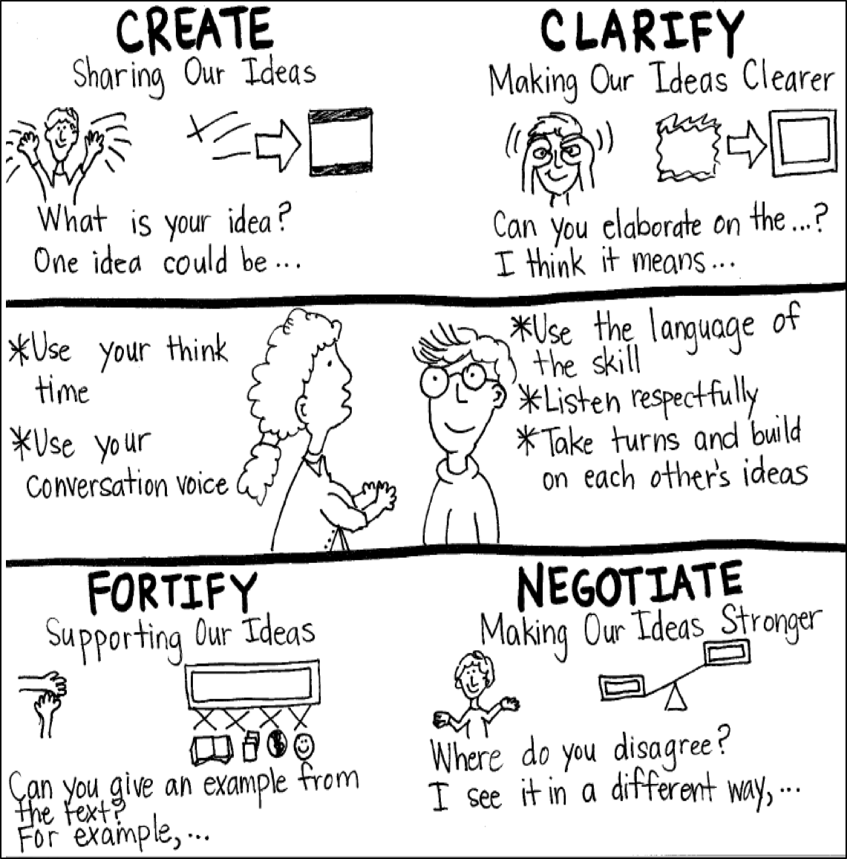
Model Creating Class Constructive Conversation Poster
Sample
Notes:
Teacher models creating a Constructive Conversation Poster. This slide is a resource. Teacher elicits student responses to help student develop a poster that illustrates their understanding of the NEGOTIATE skill and conversation norms.

Slide 51
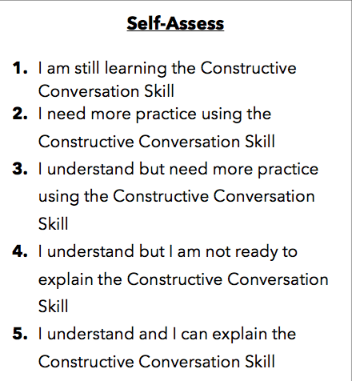
Notes:
Teacher will review the Constructive Conversation Skill NEGOTIATE
Students will self-assess answering the prompt
Teacher may select a conversation pair to share out.
EXAMPLE:
Student: I rated myself a 3 because…
Teacher: What can you do to move to a 4?

Slide 52
Teacher Resources

Slide 53
NEGOTIATE Non-Model Revision

